Slide 1
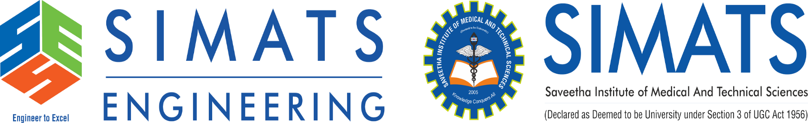
Vision-Based Real-Time Screen Layout Analysis and Background
Anomaly Detection
Presented by : Galla Sai Siddartha (192425093)
: Kandukuri Vijay Bhaskar Reddy (192425155)
: Yuvaraj D (192421230)
Subject code : ITA0512
Subject : Computer Vision
Guide name : Dr. Christy Melwyn
Date : 12/08/2026

Slide 2


ABSTRACT
Develops a real-time system for monitoring and analyzing computer screen content.
Captures screens from monitor at configurable time intervals.
Uses Dual OCR to extract text displayed on the screen.
Applies YOLOv8 to classify and detect different types of visual content.
Analyzes sensitive keywords and suspicious on-screen activities.

Slide 3
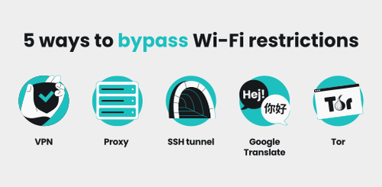
INTRODUCTION
Need: Modern desktop compliance beyond simple URL filters.
URL Limits: Fails on desktop .exe apps, games & changing URLs.
Visual Gap: URL filters cannot inspect actual screen text/UI.
Solution: Offline security suite with Dual OCR, YOLOv8 & active Win32 control.

Slide 4
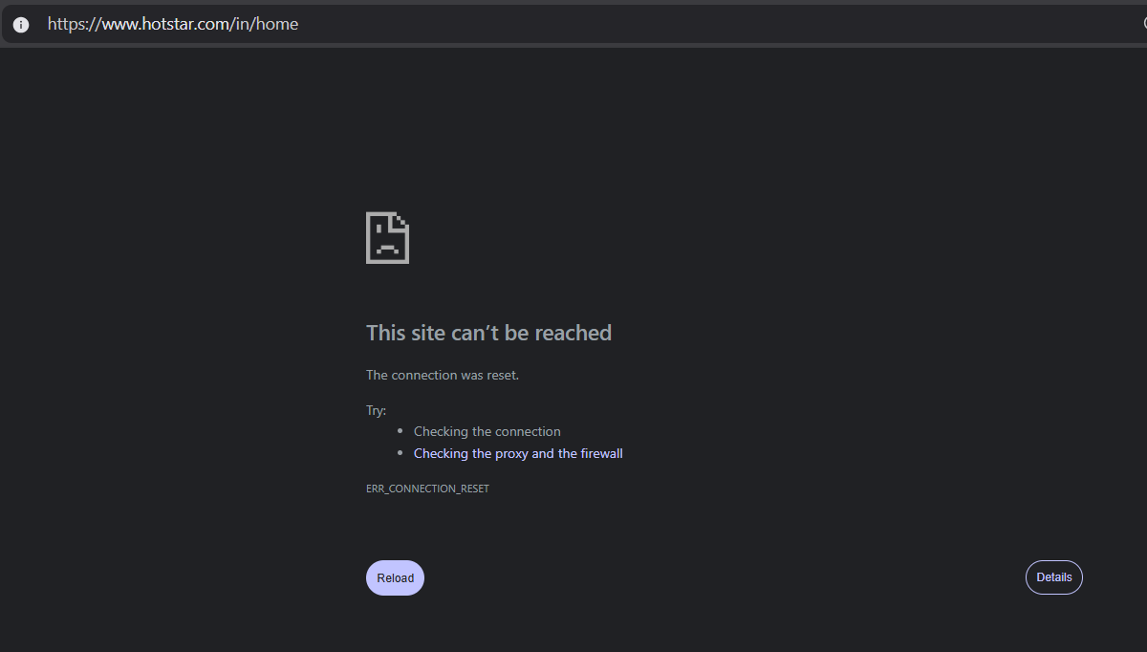
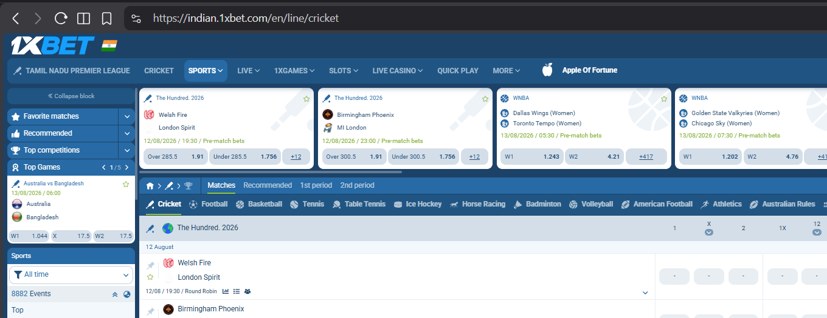
PROBLEM STATEMENT
URL Blacklist Bypasses: Ignores native desktop apps, games & offline tools
No Visual Awareness: Cannot inspect rendered UI or confidential on-screen text
Static & Reactive Rules: Blocklists become outdated against new threats
No Active Mitigation: Legacy tools log events but fail to stop non-compliant apps

Slide 5
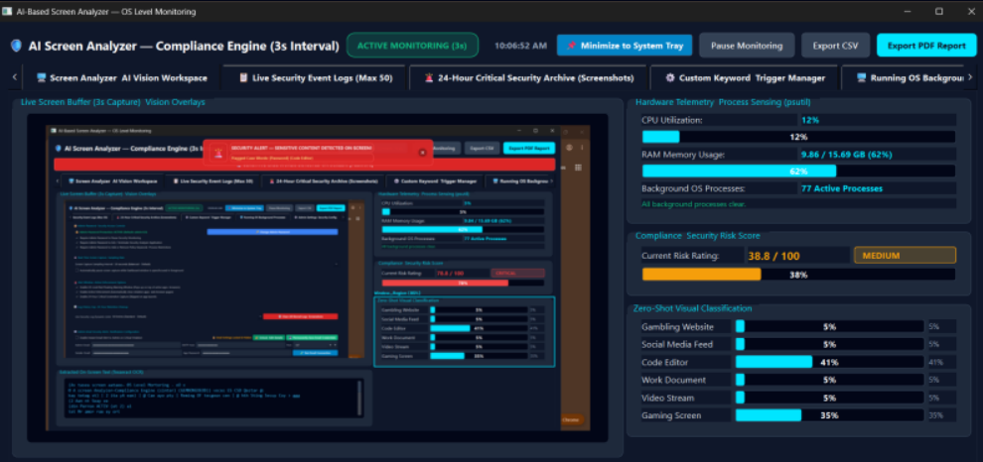
OBJECTIVE
Screen Capture: Multi-monitor sampling at 1s–10s intervals via MSS
Multi-Tier OCR: PyTesseract C++ + Zero-Setup Native Windows Media OCR
YOLOv8 Analytics: Offline zero-shot classification without cloud lag
Dynamic Risk Engine: 0–100 score, Green/Yellow/Red status & OS warning overlay
Active OS Enforcement: Kill restricted .exe processes & close browser tabs (WM_CLOSE)

Slide 6
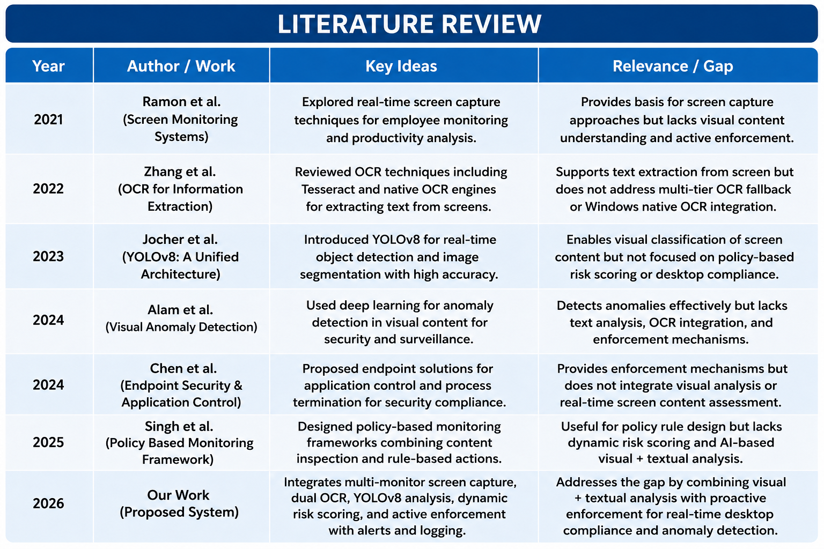
LITERATURE REVIEW

Slide 7
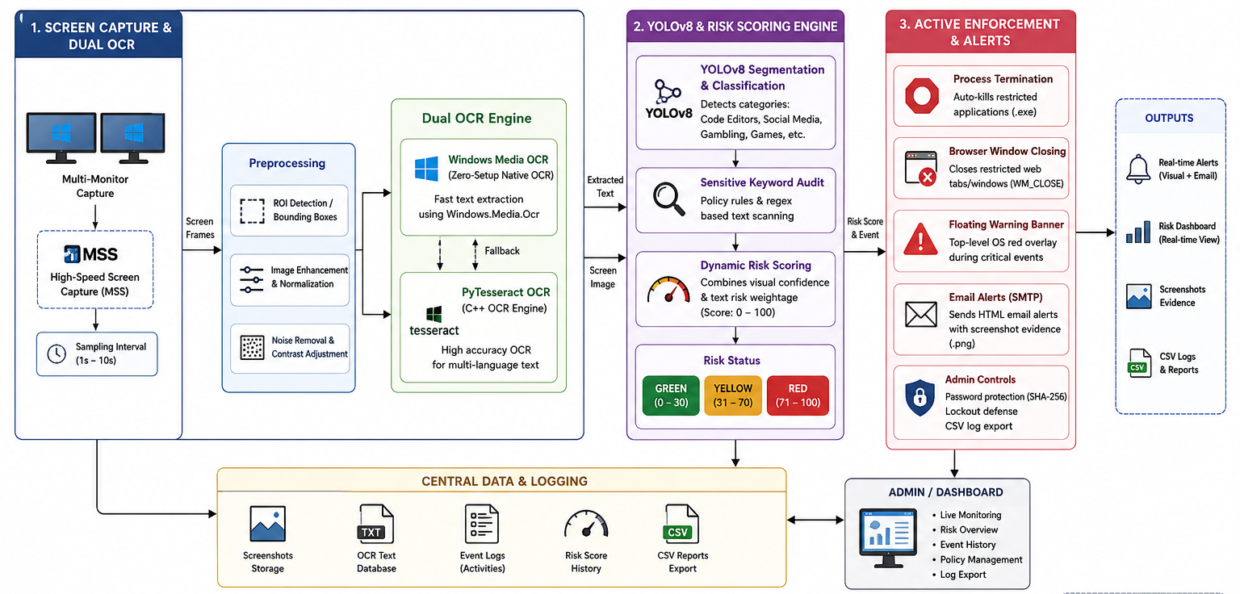
ARCHITECTURE DIAGRAM

Slide 8
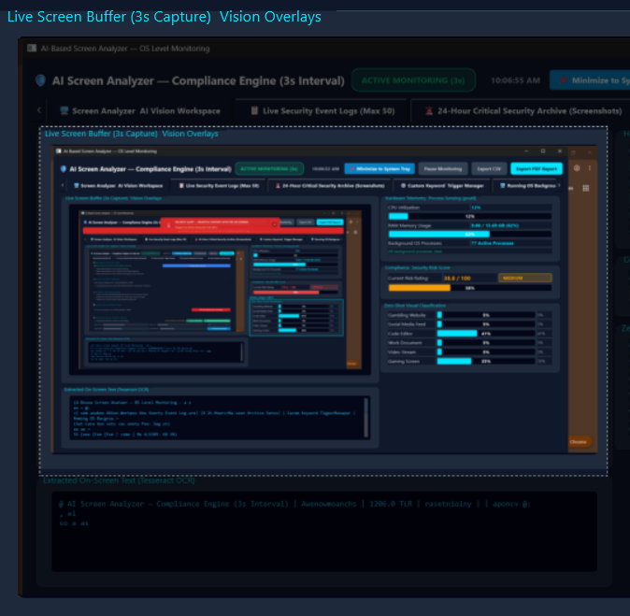
Module 1 – Screen Capture & Dual OCR
Multi-Monitor Grabber: High-speed display enumeration using MSS
Configurable Frequency: 1s to 10s background sampling rate
Zero-Setup WinOCR: Built-in Windows.Media.Ocr for instant setup
Fallback PyTesseract: High-accuracy C++ OCR for multi-language text
ROI Preprocessing: Automatic bounding box extraction & image normalization

Slide 9
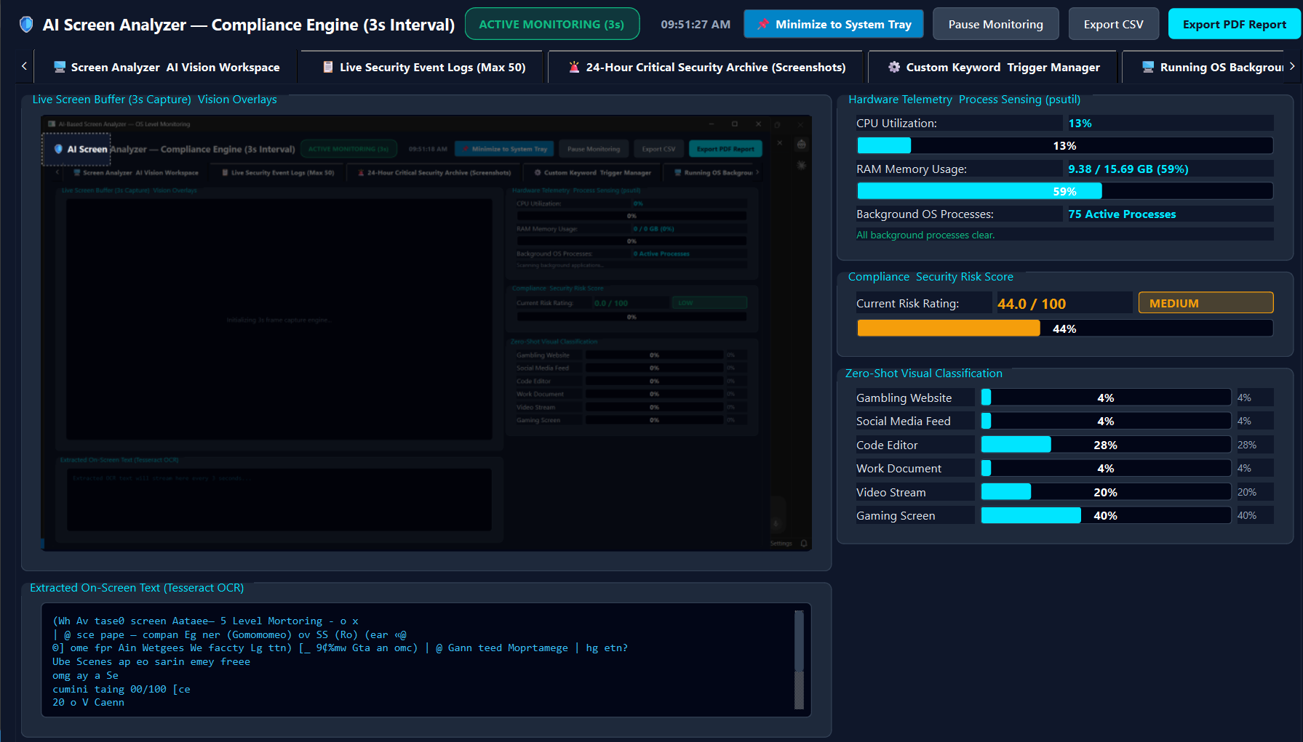
Module 2 – YOLOv8 & Risk Scoring Engine
YOLOv8 Segmentation: Local category detection (code, social media, gambling)
Sensitive Keyword Audit: Scans text against policy rules & regex patterns
Dynamic Risk Score: Combines visual model confidence & text weighting (0–100)
Status Badges: Green (0-30), Yellow (31-70), Red (71-100) threat levels
Data Masking: Automatic masking of SSNs, credit cards & passwords in logs

Slide 10
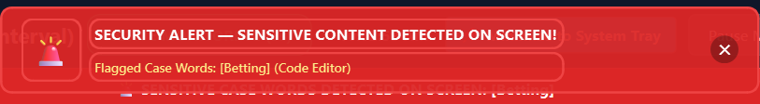
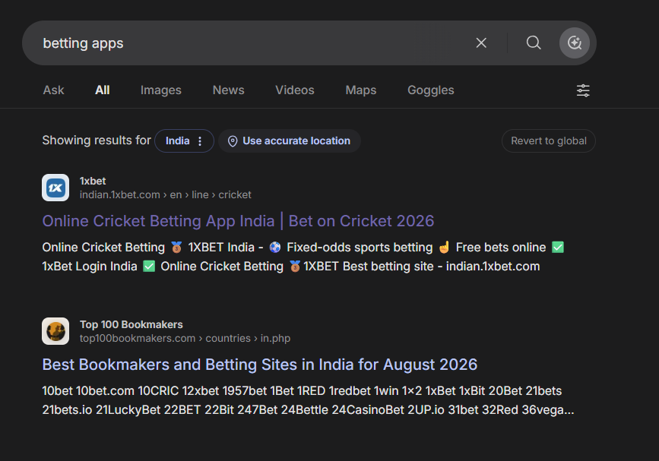
Module 3 – Active Enforcement & Alerts
Process Termination: Auto-kills restricted apps (poker.exe, cheatengine.exe)
Browser Window Closing: Gracefully closes restricted web tabs via WM_CLOSE
Floating Warning Banner: Top-level OS red overlay during critical events
SMTP Email Alerts: Background HTML alert emails with screenshot evidence .png
Admin Controls: SHA-256 password protection, lockout defense & CSV log export

Slide 11
IMPLEMENTATION

Slide 12

TOOLS & TECHNOLOGIES
Python – Used as the main programming language for system development.
Windows Media OCR – Provides native and zero-setup text extraction.
PyTesseract OCR – Used as a fallback for accurate and multilingual OCR.
YOLOv8 – Used for real-time visual detection and screen-content classification.
OpenCV – Used for image preprocessing, enhancement, and analysis.
SMTP – Used to send real-time email alerts with screenshot evidence.

Slide 13
RESULTS
The system successfully captures and analyzes screen content in real time.
Dual OCR extracts visible on-screen text for further analysis.
YOLOv8 classifies different screen categories such as code editors, social media, and gaming content.
The risk engine generates a 0–100 compliance risk score based on visual and textual analysis.
Detected activities are classified into Green, Yellow, and Red risk levels.

Slide 14
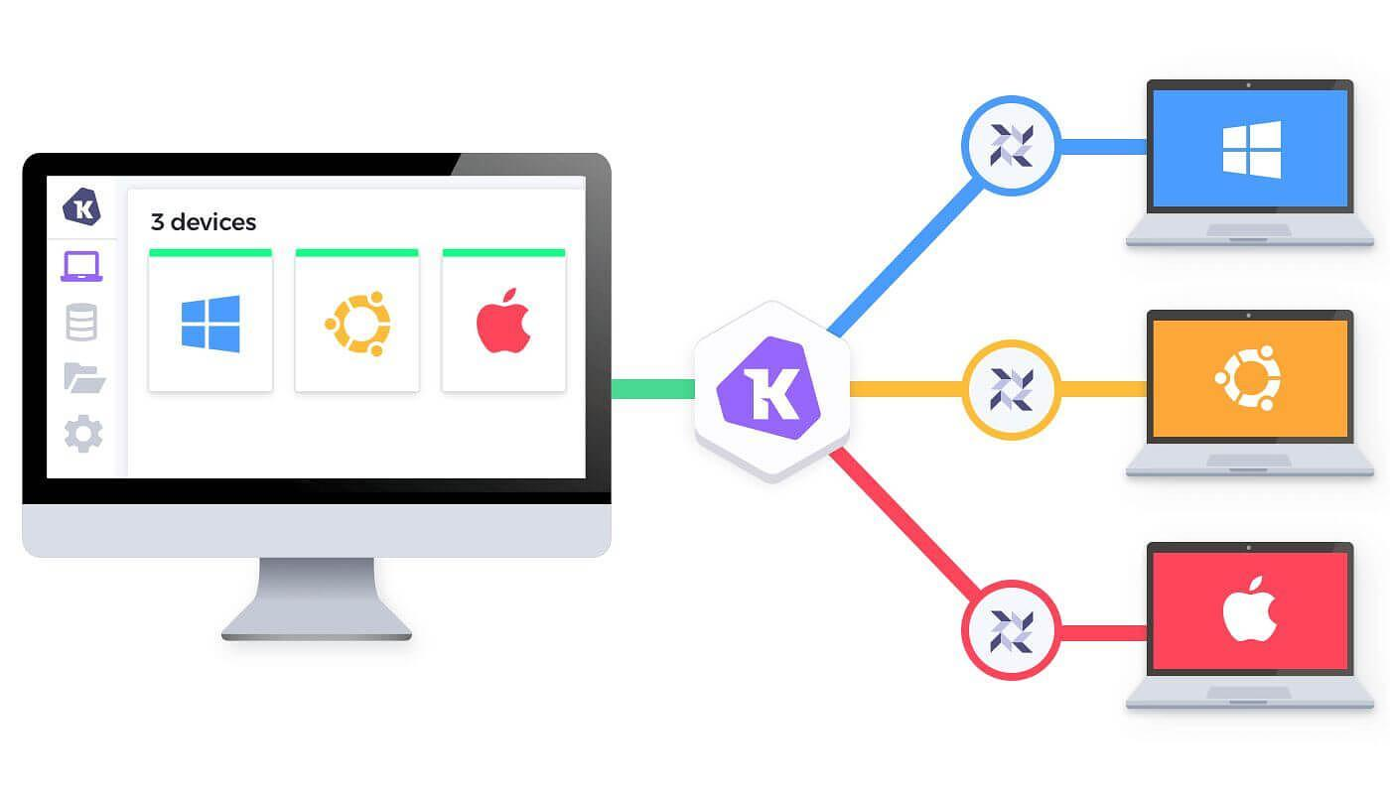
FUTURE ENHANCEMENTS
Develop a centralized enterprise dashboard for monitoring multiple systems from one platform.
Extend the system for cross-platform support such as Linux and macOS.
Integrate more advanced AI models to improve visual anomaly detection accuracy.
Add real-time cloud synchronization for centralized monitoring and data backup.

Slide 15
CONCLUSION
Comprehensive Protection: Complete offline desktop compliance & enforcement suite
Surpasses URL Blockers: Visually analyzes active screen text & application UI
Zero Setup Dependency: Operates out of the box via Native Windows Media OCR
Active Proactive Mitigation: Kills unauthorized processes before data leaks occur
Future Roadmap: Enterprise server dashboard & cross-platform agent deployment

Slide 16
REFERENCES
Ray Smith, “An Overview of the Tesseract OCR Engine,” Proceedings of the Ninth International Conference on Document Analysis and Recognition (ICDAR), pp. 629–633, 2007.
Glenn Jocher, Ayush Chaurasia and Jing Qiu, “Ultralytics YOLOv8,” Ultralytics Software Documentation, Version 8.0.0, 2023.
Microsoft, “Windows.Media.Ocr Namespace,” Microsoft Learn, documentation for Optical Character Recognition APIs in Windows applications.
Yunkang Cao, Xiaohao Xu, Jiangning Zhang, Yuqi Cheng, Xiaonan Huang, Guansong Pang and Weiming Shen, “A Survey on Visual Anomaly Detection: Challenge, Approach, and Prospect,” 2024.

Slide 17


